Slide 1
Data and PC Securer
Project Guide:
Er. Gulista Khan
Assistant Professor
By: SHREY KUMAR JAIN
B.TECH CS IV YEAR
COE, TMU
MORADABAD
(U.P.)

Slide 2
Why Cryptography?
Many of the computer user wants to send such type of data that can be only seen by the person
In this project I’ve implemented different cryptographic and Steganography techniques to get data secure.

Slide 3
Requirement:
Processor Pentium 4 / Dual Core
Operating System Windows Vista / 7
Other Support .Net Framework 4.0
Connection* Internet, Wi-Fi, Bluetooth

Slide 4
Technology requirement:
Visual Studio: We have Microsoft Visual Studio 2010 Ultimate.
Processor: Minimum requirement is Pentium Dual core for Visual Studio.
Operating System: Microsoft windows Vista. We worked on windows 7.
Human resource: any group or individual can develop such.
Submission: The project is to be submitted in college as Major Project.
User Group: Generic and can be used by all computer users.

Slide 5
Software Basis:
to implement simple to advance cryptographic techniques
simple data hiding techniques
a user friendly generic software.

Slide 6
Modules:
Splash Screen
Password
Encryptor
Decryptor
Hidden Message
Folder Compressor
Wi-Fi / Email Sender
Other.

Slide 7
Output:
software is generic
anyone who knows a little bit of computer operation can use it

Slide 8
Future Enhancements and Updates
Making software much more easier and user friendly
Separate modules as per User requirement
Usage of different types of keys and Encryption Algorithm to make data very secure.
Complete Erasure Module, to erase data completely from the Disk drive or from removable disk.

Slide 9
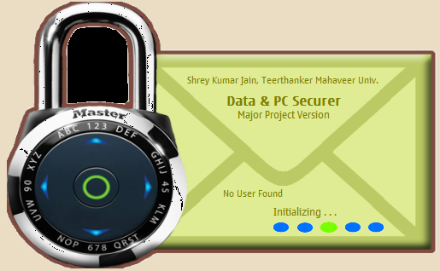
Splash Screen
Live working Splash Screen for the application, it can show:
Total user
Identify user as Administrator
Database connectivity

Slide 10
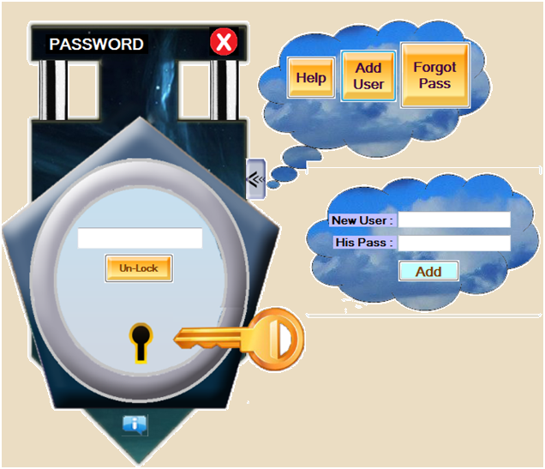
Password
Password module is used to verify the user for his key management and also for saving the best output folder that he wants. Also it provides only administrator of the computer the right to add or remove any user, also can provide new password for any user in case he/she forgets password.

Slide 11
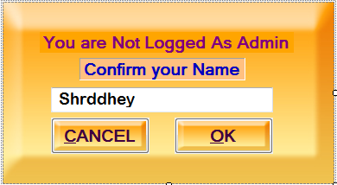
Name Verification
As in password module you had seen that only password is only taken for authentication, this was because I’d developed this project mainly for administrator. So, now for user other than administrator must also verify his/her name for further authentication after entering password.

Slide 12
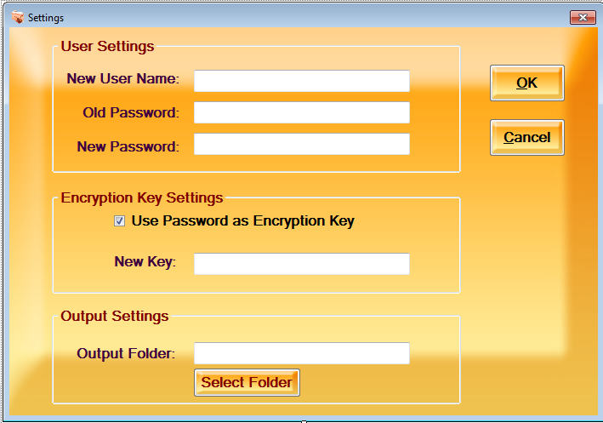
Settings
Settings provide the Administrator to edit profile of any user and also provide any user to personalize settings like:
New user name
New password
New key
Output folder

Slide 13
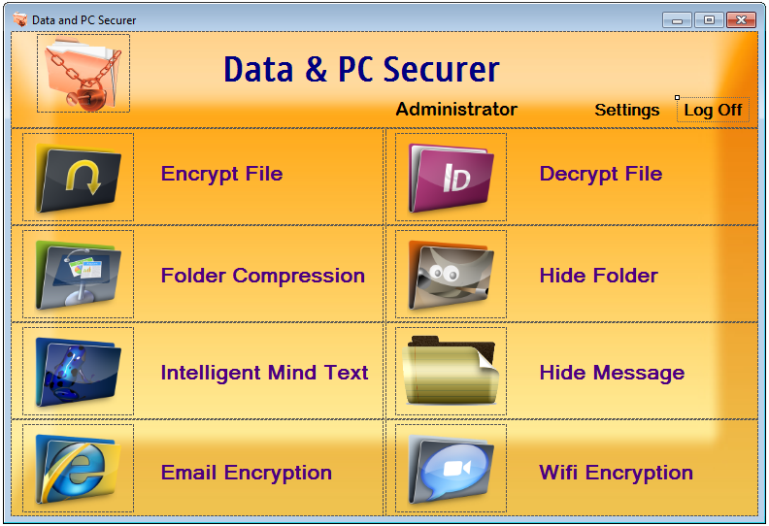
Data & PC Securer
Encrypt file
Decrypt file
Folder compression
Hide folder
Intelligent human readable text
Hide message
Email encryption
Wifi sending of encrypted file

Slide 14
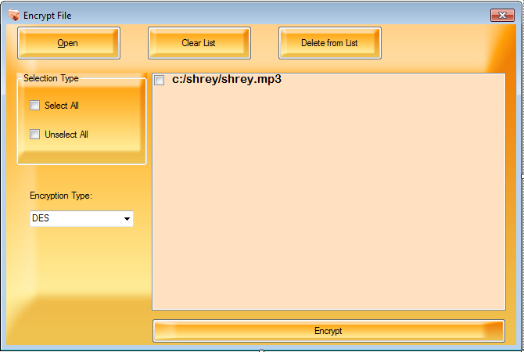
Encrypt File
Take any number of files to encrypt
Encryption can be done in many ways like:
DES
AES
UNI-CIPHER

Slide 15

Decrypt Files
User can only decrypt the file that is encrypted by him only or case he/she wants to decrypt others file, must need his password

Slide 16
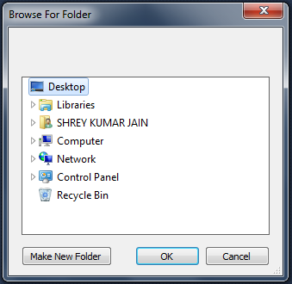
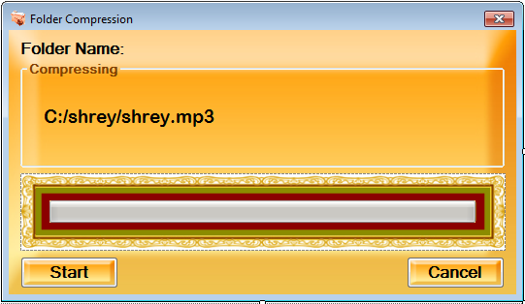
Folder Compression
Folder compression compresses all files in the selected folder. The compression technique used is GZ compression.

Slide 17
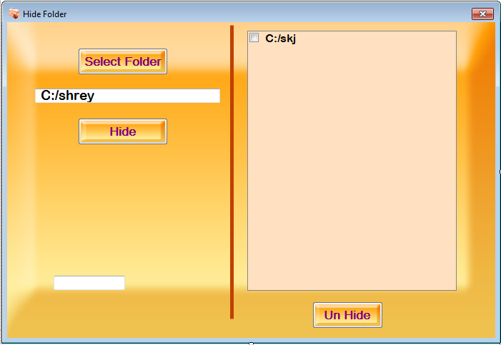
Hide Folder
Hide folder module can be used to hide any folder by applying attributes to the folder as hidden, non readable, unlink, etc.

Slide 18
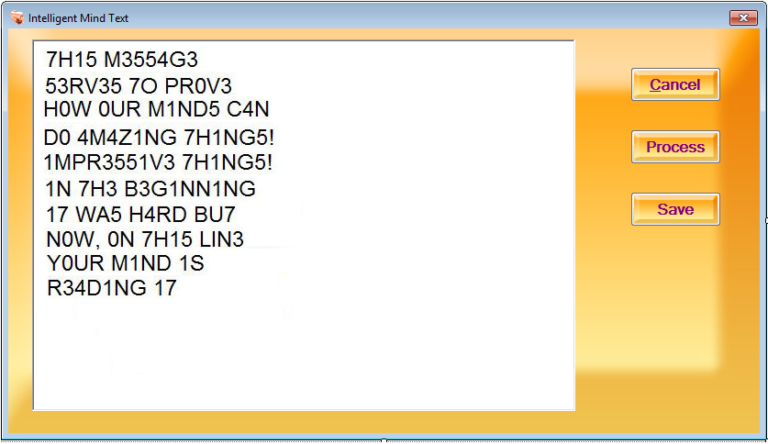
Intelligent Human Readable Text
This module converts text into such format that only human mind can judge what letter or word it is. User can save the text and also can send it to others.

Slide 19
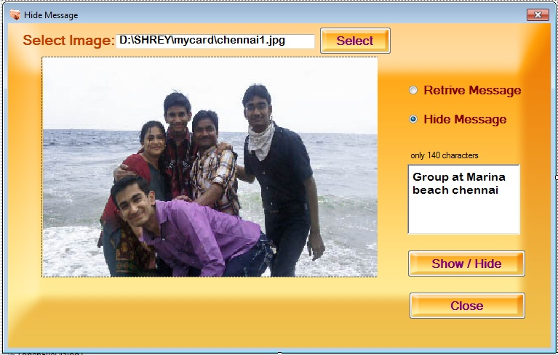
Hide Message
Hide Message module can hide any text message in any format of image, basically we can implement such hiding technique for any file but in this version of project I’ve only used for Images

Slide 20
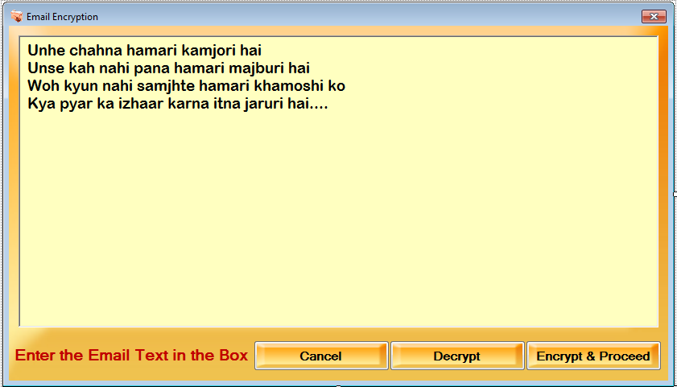
Email Encryption
Email encryption provides user to first encrypt the text he/she wants to send and then move that text to the email client application by which user can send email with attachments to anyone in the world without opening the actual email web client. Emails are sent by SMTP server with authentication.

Slide 21
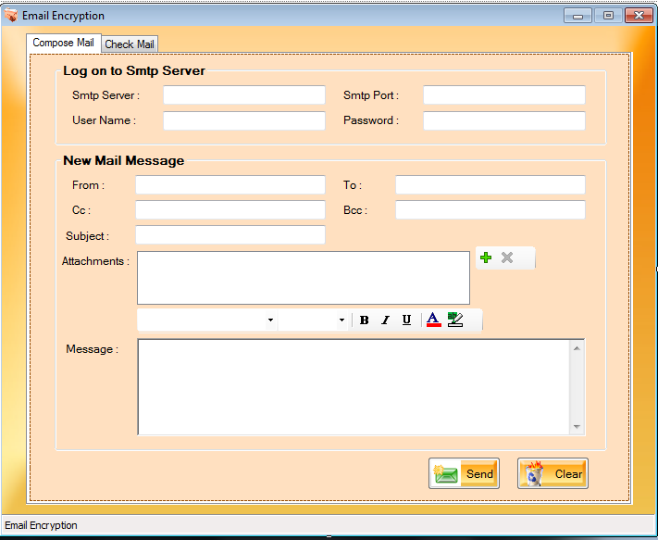
Email Encryption…. Cont.

Slide 22
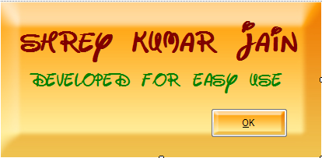
About
Thank You
By: Shrey Kumar Jain

